Slide 1
Abstractive Text Summarization
Presented By:
Name:DHAYANITHI T
ID:STB030018
Associated with Scifor Technologies

Slide 2
Introduction
Text summarization refers to the technique of shortening long pieces of text.
Summarize by the main points.
Accelerates the process of information retrieval.
Discover relevant information and consume faster.
Increases the amount of information that can fit in an area.
Expensive and time consuming if done without machines.
Machine learning algorithms can be trained to comprehend documents and identify the sections that convey important facts and information before producing the required summarized texts.

Slide 3
Types of Text Summarization
Abstraction-based:
Paraphrasing and shortening parts of the source document.
Create new phrases that relay the most useful information from the source.
Could overcome grammar irregularities of the extractive approach.
Generally more difficult to develop.
Example
Source text :
Joseph and Mary rode on a donkey to attend the annual event in Jerusalem. In the city, Mary gave birth to a child named Jesus.
Extractive summary :
Joseph and Mary came to Jerusalem where Jesus was born.

Slide 4
Types of Text Summarization
Extraction-based Summarization:
Lex Rank:
A graphical based text summarizer.
Luhn :
One of the earliest algorithm, named after famous IBM researcher.
Scores sentences based on frequency of the most important words.
Latent semantic analysis (LSA):
An unsupervised method of summarization it combines term frequency techniques with singular value decomposition to summarize texts.
TextRank:
Weighted-graph-based summarization with keyword extractions from source.
*Above are all non-ML or unsupervised methods.

Slide 5
Objective
To Develop an Interactive Web Application:
The primary goal is to build a user-friendly, interactive web application that allows users to input text and receive summarized content in real-time.
This application leverages the advanced natural language processing capabilities of the txtai library to provide accurate and concise summaries.
Streamlit for Enhanced User Experience:
Employ Streamlit's capabilities to create a sleek and responsive UI/UX, ensuring that the application is accessible and easy to use for a wide range of users, from students and researchers to professionals.

Slide 6
Tech Stack
Any IDE
txtai
streamlit
PyPDF2
Transformers:
This is a core library used in txtai. Developed by Hugging Face, it provides a vast collection of pre-trained models for NLP tasks like text classification, summarization, translation, and question-answering.
TensorFlow or PyTorch:
These are the primary deep learning frameworks used by the models in the Transformers library. txtai can work with models trained on either of these frameworks.

Slide 7
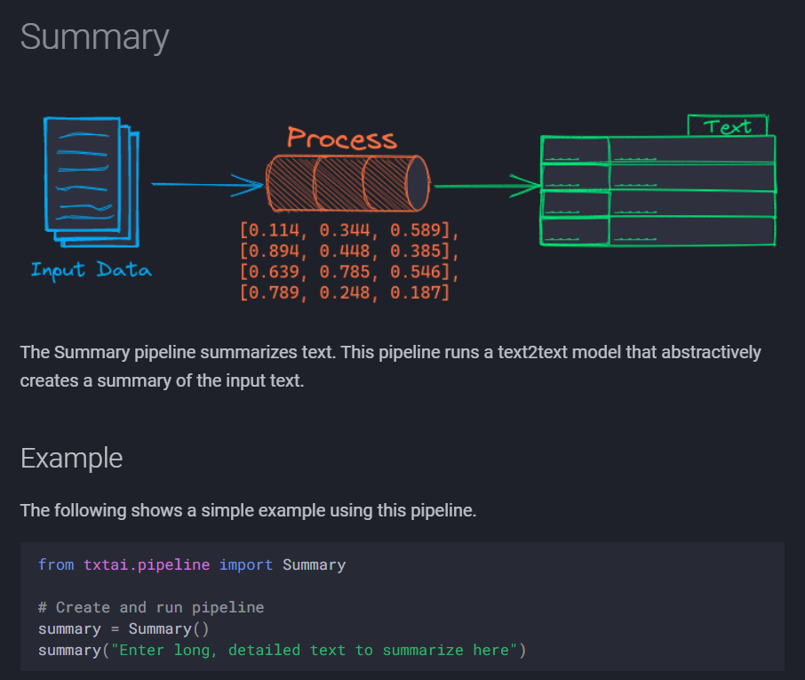
Algorithm

Slide 8
Algorithm
Natural Language Toolkit:
Leading platform for building Python programs to work with human language data.
NLP is a field of computer science, artificial intelligence (also called machine learning), and linguistics processing.
Interactions between computers and human (natural) languages.
It provides suite of text processing libraries for classification, tokenization, stemming, tagging, parsing, and semantic reasoning.

Slide 9
Algorithm
Following are the NLTK Libraries used in text summarization:
Word tokenizer.
Sentence tokenizer.
Stopwords.
BeautifulSoup.
Numpy library.
Tagging.
Parsing.

Slide 10
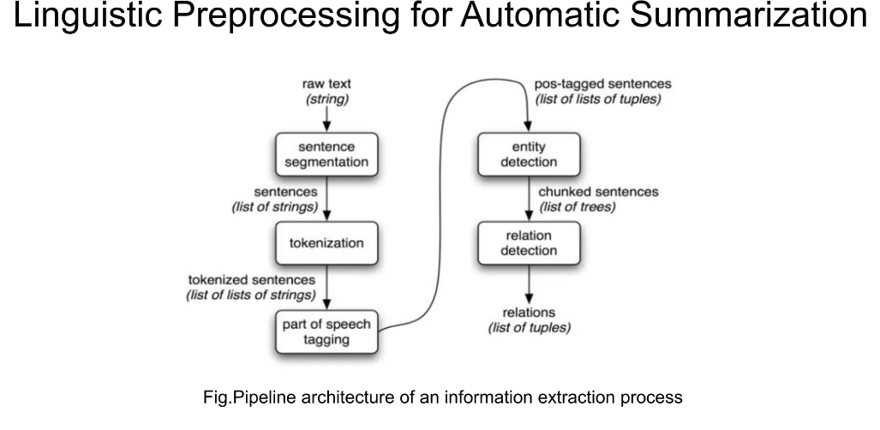
Algorithm

Slide 11
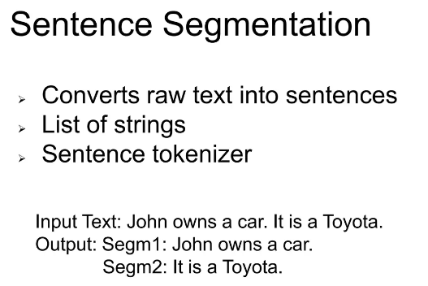
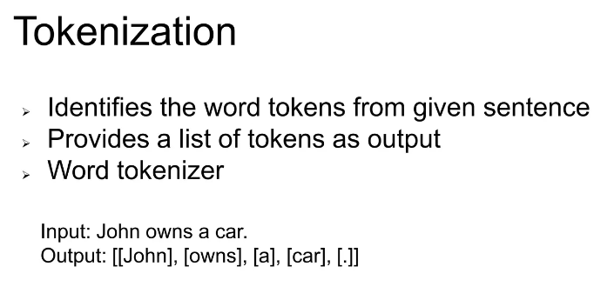
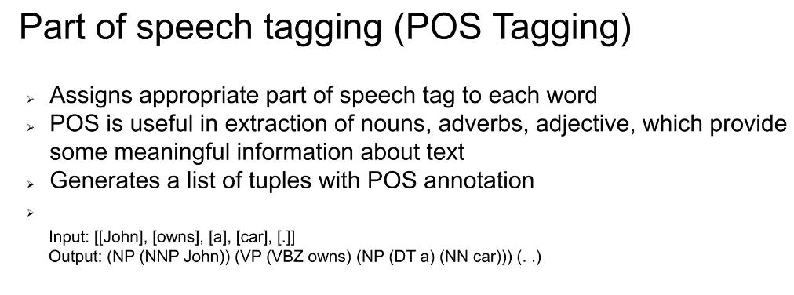
Algorithm

Slide 12
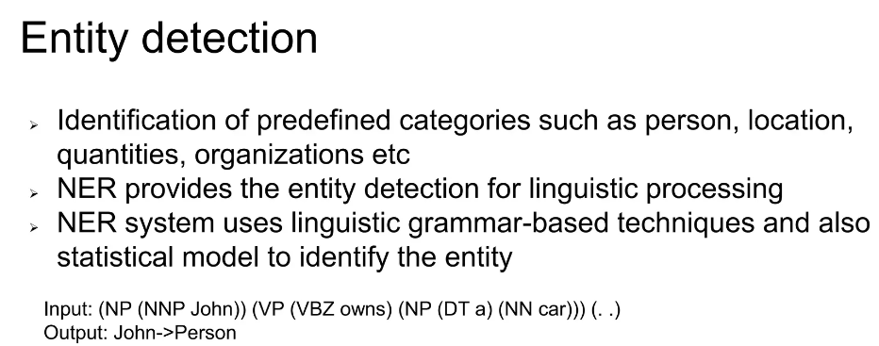
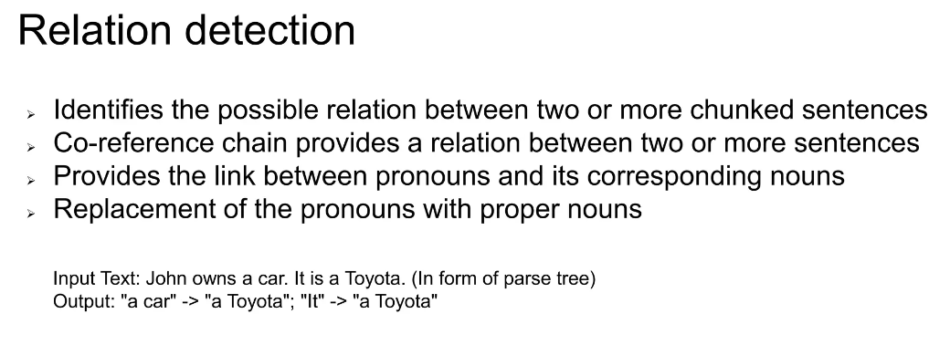
Algorithm

Slide 13
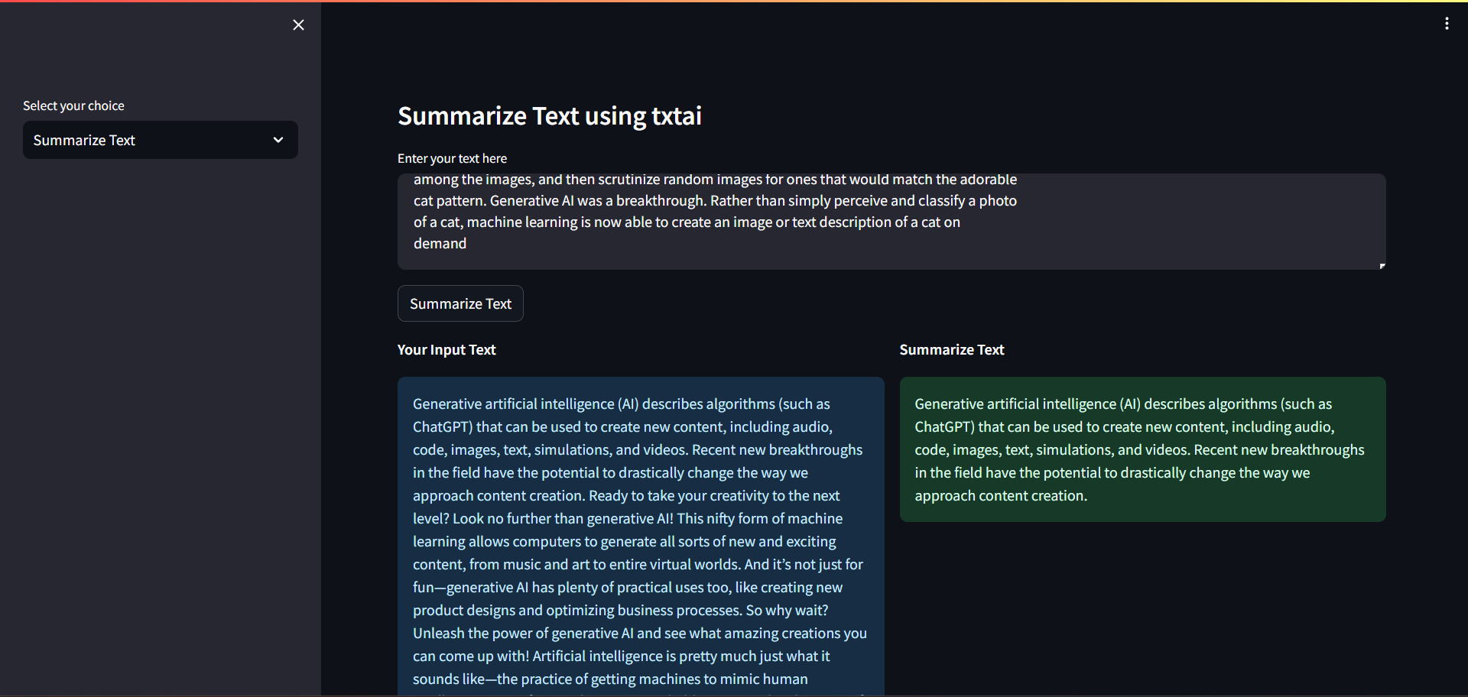
Output

Slide 14
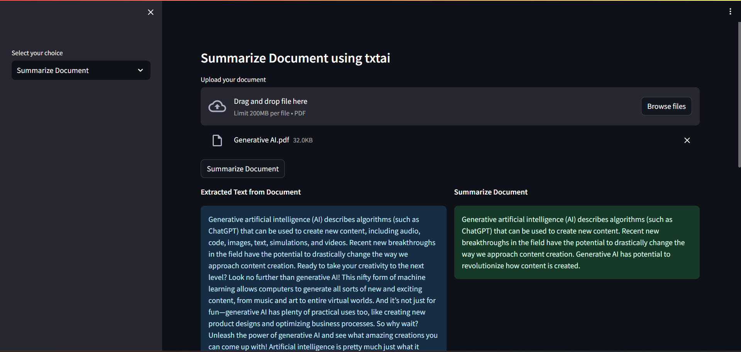
Output

Slide 15
Conclusion
Advanced NLP Capabilities: The use of txtai for text summarization represents a significant advancement in natural language processing (NLP). By leveraging state-of-the-art AI models, txtai has demonstrated a remarkable ability to distill lengthy texts into concise, coherent summaries, effectively capturing the essence of the original content.
Efficiency and Time-saving: The application of txtai in summarizing texts offers substantial time-saving benefits.
Accuracy and Contextual Understanding: Through its sophisticated algorithms, txtai maintains a high level of accuracy in understanding and retaining the context and key elements of the source material.
Benefits to Users:
Accessibility of Information
Application Across Various Fields.

Slide 16
THANK YOU!

